Slide 1

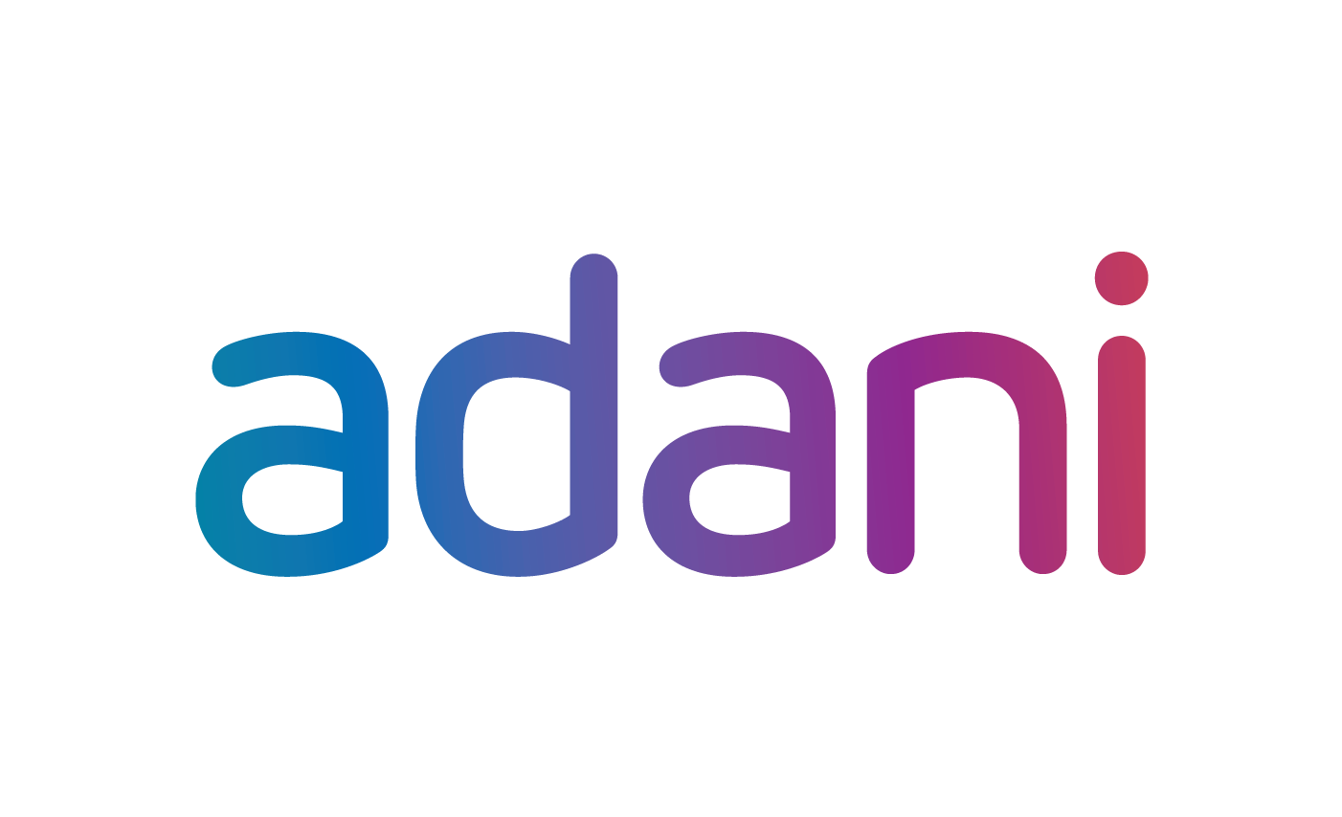

Adani vs Hindenburg
MBA672A
Submitted To: Submitted By: GROUP 5
Prof. Abhinav Tripathi (22125008) Adhish S
DIME (21125046) Mohd Rahim
IIT Kanpur (21104075) Puneet Shrivastava
(22125074) Rupesh Kumar
(200841) Sairam Nayak Kunsoth

Slide 2

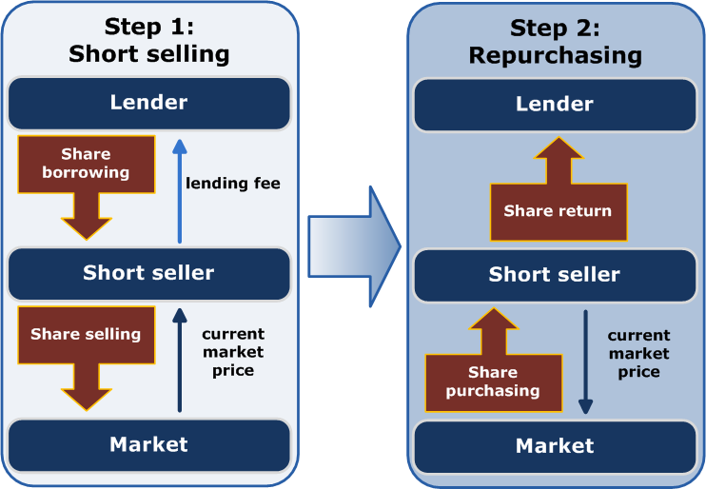
Introduction
Hindenburg -> Profits from short-selling
Self-created issues -> Fall of company stock prices
Released a report on the Adani group
A divided public opinion
Hindenburg's motives for profit should not be ignored
It's important to read and understand the report

Slide 3

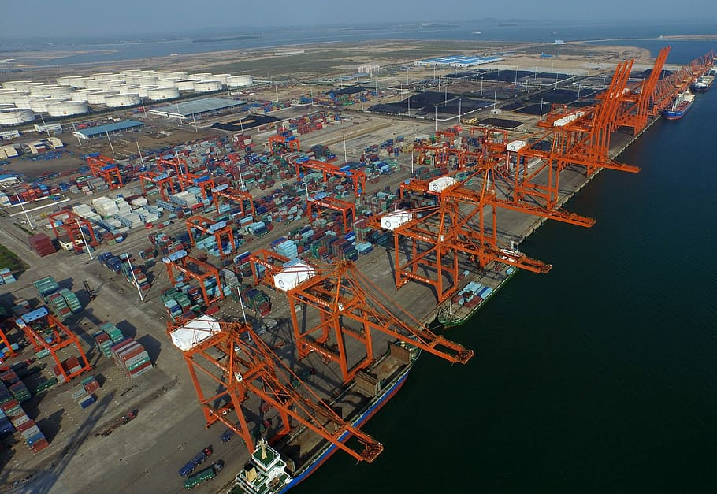

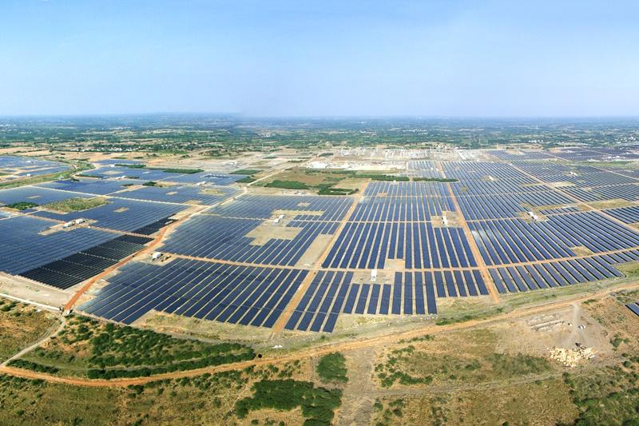
Adani Group
Leading Conglomerate in India founded in 1988
Diversified into various sectors
Adani Ports and Special Economic Zone
Adani Green Energy
Adani Enterprise
Adani Total Gas
Subsidiaries deliver impressive results

Slide 4
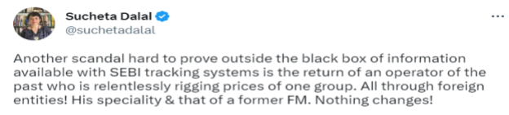
Sucheta Dalal vs Adani
Well known journalist: Exposed Harshad Mehta Scam
Advocate for transparency & ethical business practices
Exposure to Adani group: Importance of continued scrutiny and investigation by journalists
Discussed on Social Media: Tweet linked to drop
Rumors and speculation can impact stock prices: Be cautious
Role of journalists
Need for prudent investment decisions

Slide 5

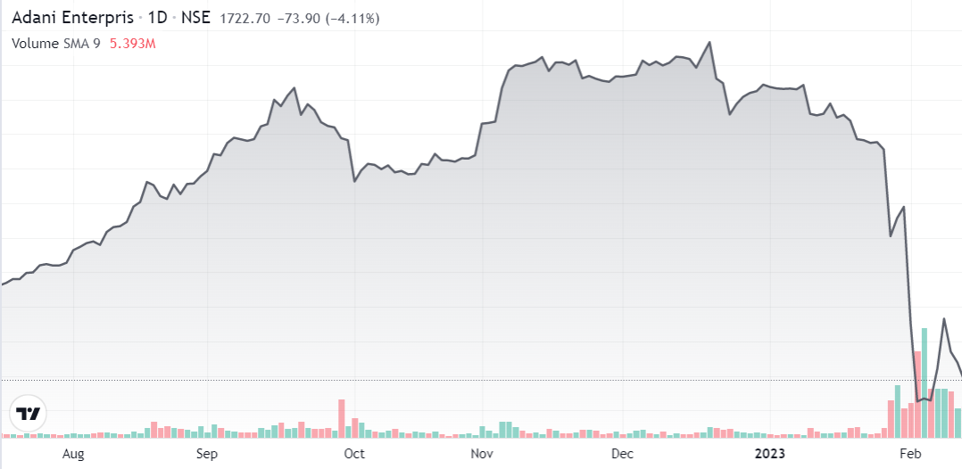
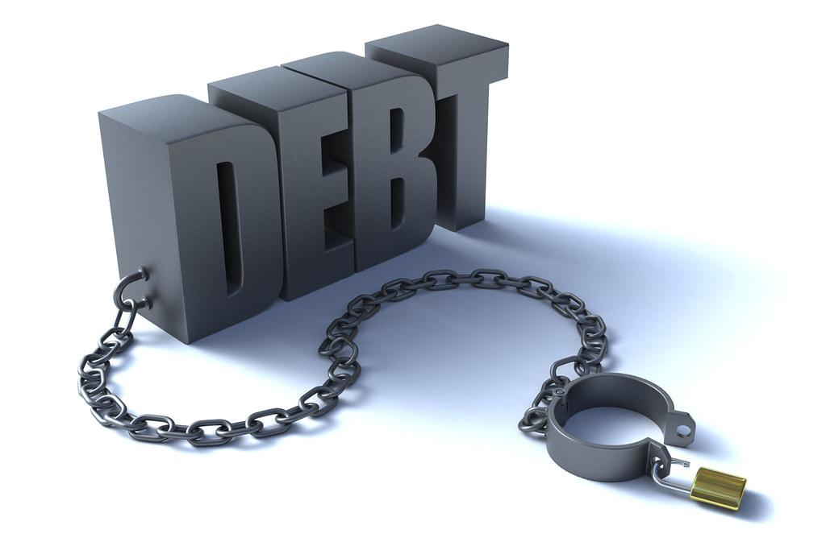
The Report
Generates public reports on frauds
Track record of targeting companies with short positions
Questions company’s fundamentals
Suggests overvaluation
Highlights extreme debt, lack of transparency
Alleges Market manipulation, money laundering
Use of influence to silence critics and media
Open challenge to answer 88 questions

Slide 6

Impact of Report
Since the release of report, all adani stocks have fallen at least 25% with adani total gas getting a set back of upto 70%. (As on 13th February, 2022).
Adani Enterprises FPO was cancelled in spite of it being oversubscribed 1.12 times. The stock has fallen over 50% since.
Markets have been more volatile, nifty decreased by -2.84% on 24th Jan.
Dow Jones has removed Adani Ports from its sustainability index(DJSI) and Adani Group companies bonds have hit distressed levels
LIC (which has a stake in Adani) and SBI (has in excess of $2 billion loan to Adani Group), came under the scanner as both are public institutions.
Chants in parliament about the alleged closeness of Gautam Adani and Prime Minister Narendra Modi.

Slide 7
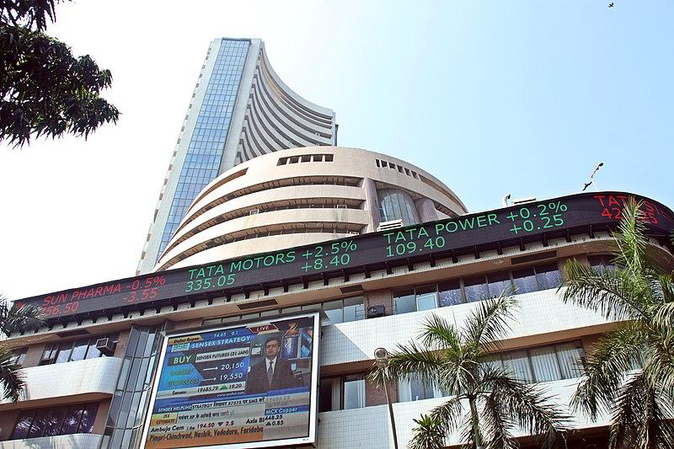
Exchange’s Response
Adani Enterprises' faced several trading halts on the Bombay Stock Exchange after the release of the report, and it eventually fell by 30% before cutting losses.
Adani Green Energy Ltd. and Adani Transmission Ltd.'s circuit limits have been updated by the National Stock Exchange of India (NSE) to 5%. Circuit limits are established by stock exchanges to avoid significant fluctuations in stock prices occurring quickly.

Slide 8

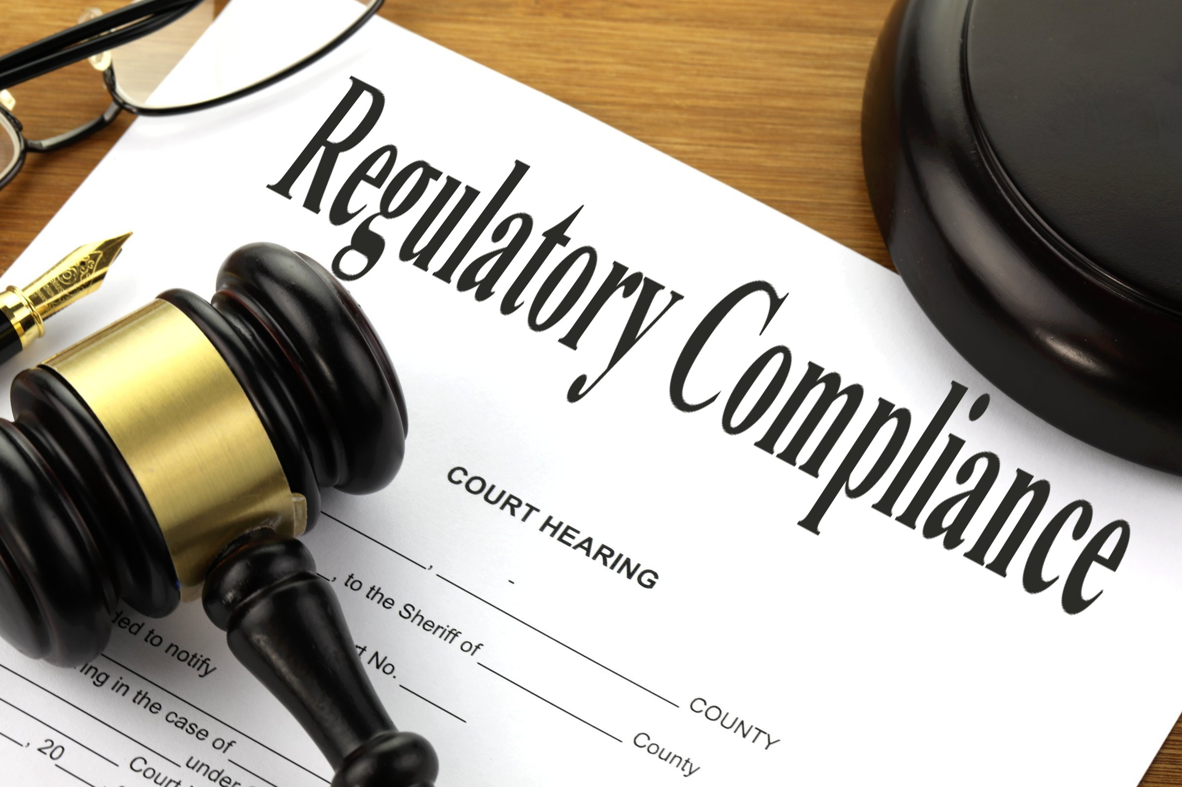

Adani’s Response
The investment funds, which controlled a sizable portion of the float, were offshore corporations. Hindenburg reported, it spoke with former workers of the business that managed one of the funds, and they indicated that "Adani owns the shares."
Hindenburg claimed that Amicorp, which was linked to the $ 4.5 billion 1MDB affair in Malaysia, had relationships with Adani Group.
Hindenburg has raised concerns about Vinod Adani, the brother of Gautam Adani, and the fugitive CA Dharmesh Doshi, who is accused of manipulating the stock market.
The group stated in a number of responses to Hindenburg's other allegations that there were numerous related party transactions to privately held Adani companies, that the transactions were carried out on an arms-length basis.

Slide 9
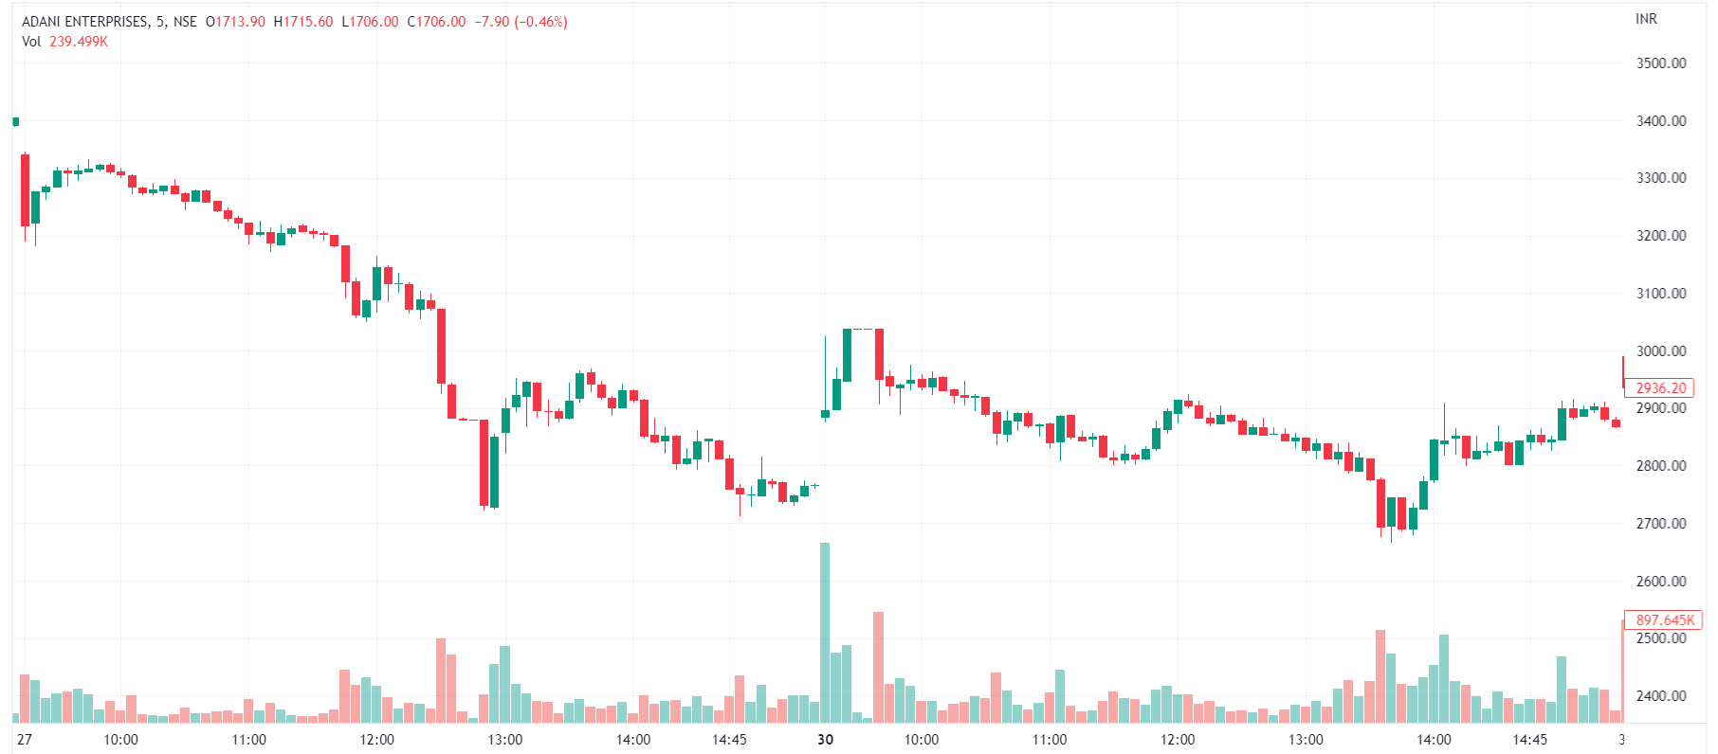
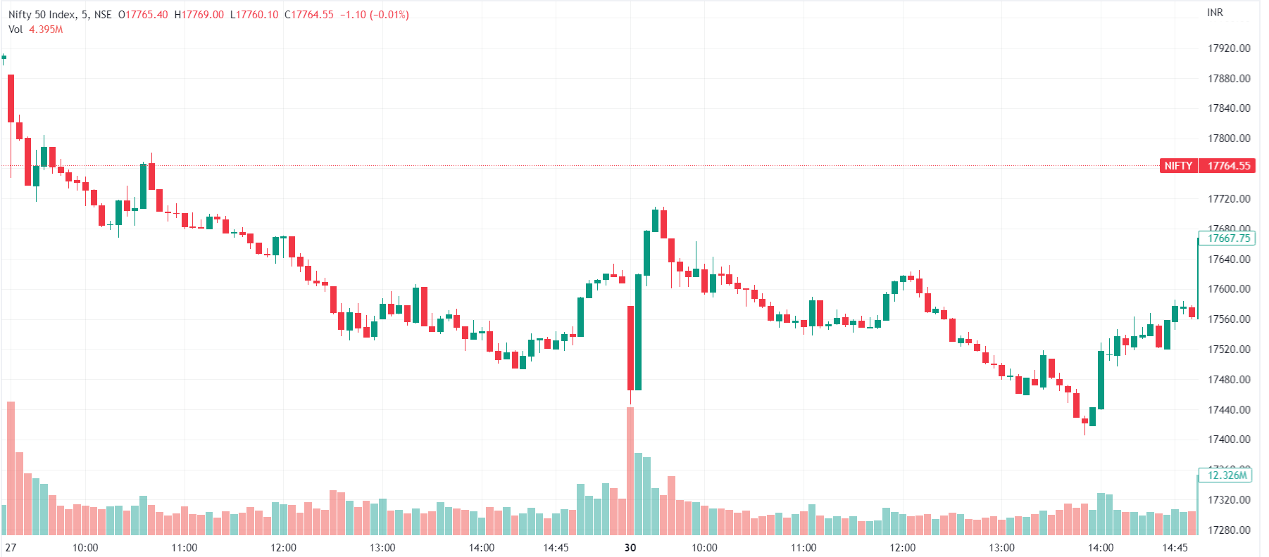
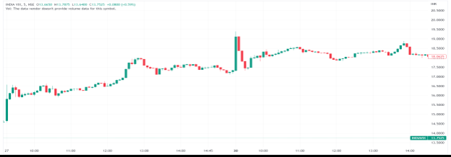
Adani Enterprises Stock
NIFTY 50
For the all the allegations put forth by Hindenburg, the Adani team has refused these allegations and said we have been transparent to all our stakeholders about our company and we are in compliance with the Indian laws.
The aftermath of Adani’s response witnessed volatility in the Adani Enterprises Stock as well as in the financial markets (NIFTY 50).

Slide 10


Analysis
Allegations of accounting fraud and environmental infractions.
Lack of ethics and transparency in the company's practices.
Unethical practices can hurt a company's financial performance and reputation.
Importance of ethical conduct and transparency in business.
Organizations should follow strict norms of transparency and accountability.
The importance of crisis communication and reputation management.
The charges may decrease the company's share prices and market value.
Allegations of opaque related-party transactions indicate a lack of transparency in financial reporting.
The regulatory response raises concerns about potential risks associated with investing in the company.
Security analysts need to take a holistic approach to assessing a company's risks and benefits.

Slide 11



Conclusion
Investors should exercise caution before investing in Adani Group.
Adani Group has been involved in controversial projects
Investors should assess the potential influence of regulatory measures on Adani Group's activities and investments in government-regulated industries.
Adani Group's financial health and stability should be evaluated
The competitive environment in Adani Group's markets should also be considered before making any investment decisions.
Investors must carefully evaluate Adani Group's track record and reputation in light of the Hindenburg Research report and controversies surrounding the company.
Investing involves inherent risks, and investors should make decisions based on accurate data.

Slide 12


